Slide 1
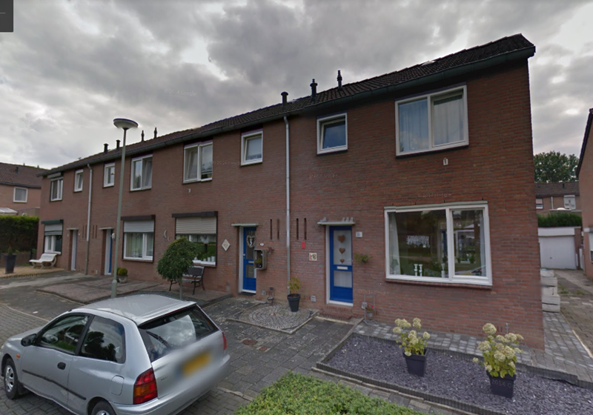
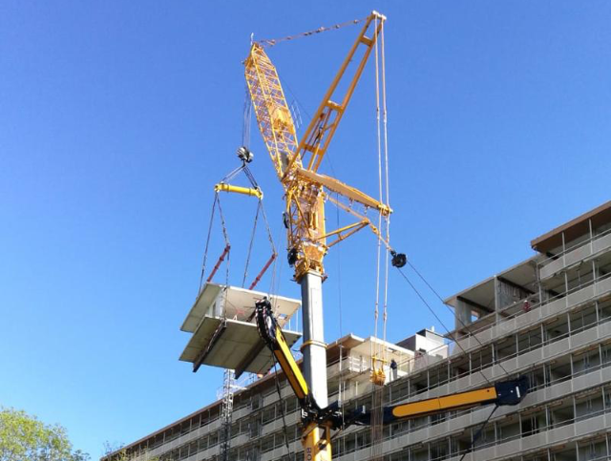
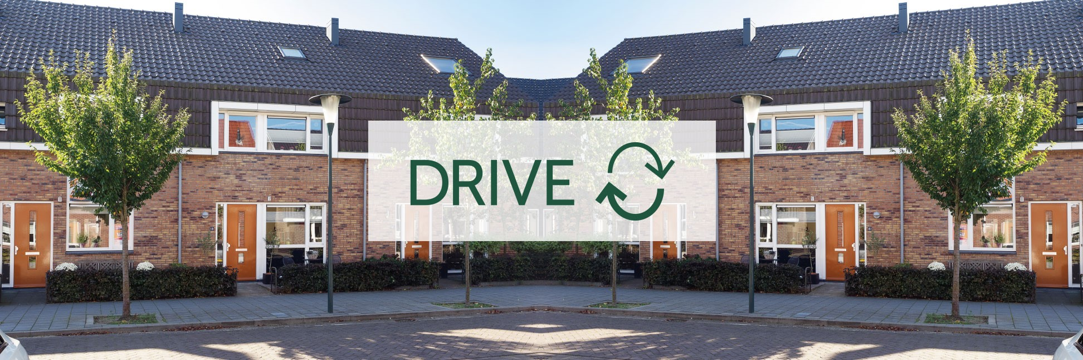





Evaluation of circularity in the Built Environment
H2020 DRIVE 0 & UIA Super Circular Estate
Driving decarbonization of the EU building stock by circular (de)construction
Michiel Ritzen
Zuyd University of Applied Sciences
Smart Urban Redesign Research Group
Technical coordinator DRIVE 0
Event:
CCHE Webinar on Indicators for Circular Economy, April 23rd 2020
This project has received funding from the European Union’s H2020 framework programme for research and innovation under grant agreement no 841850.

Slide 2
Background
Transition towards a highly decarbonized built environment in 2030.
Transition towards a 50% circular economy in 2030.

Slide 3
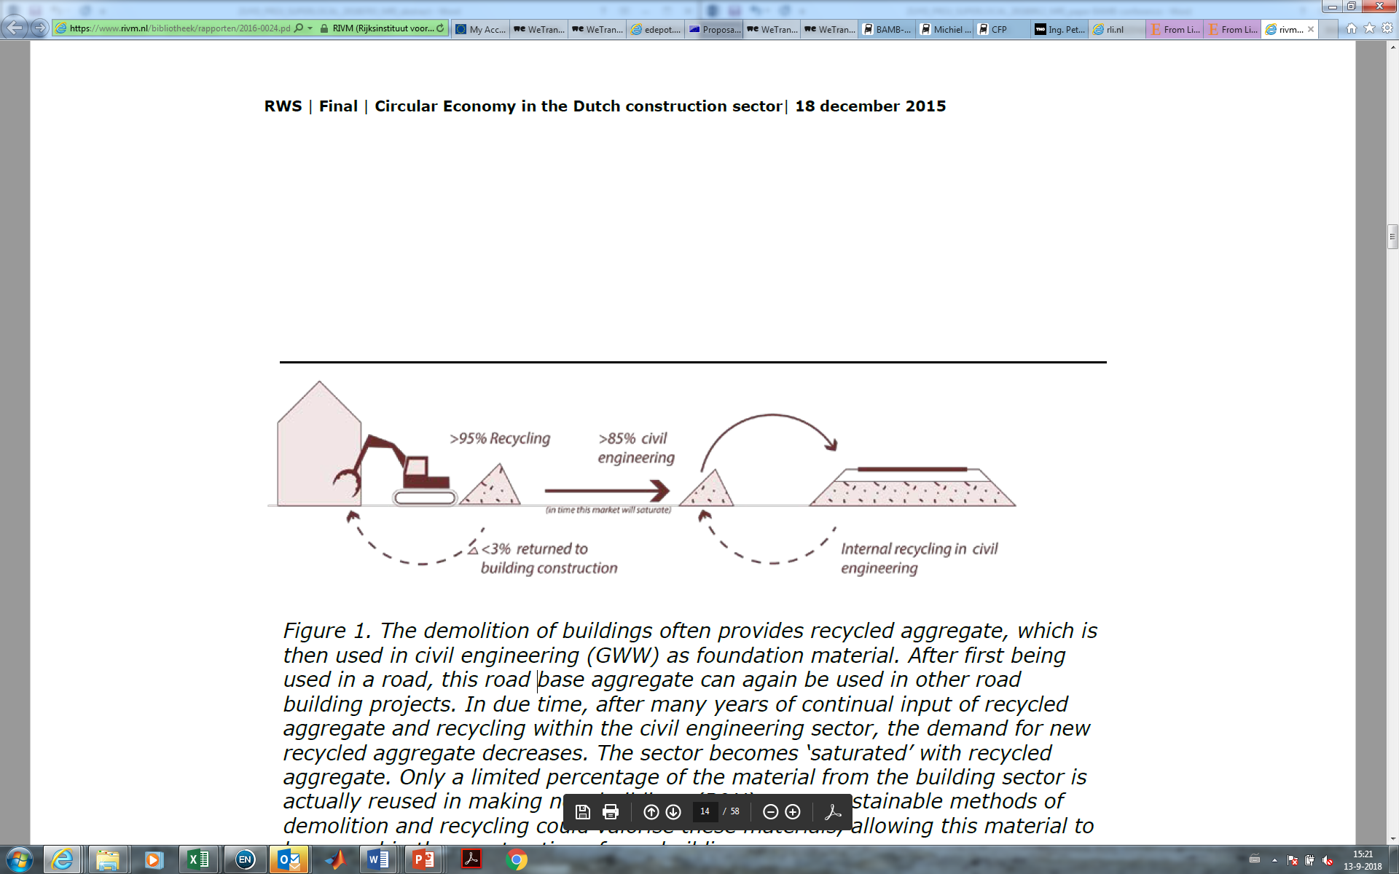
Current demolition practice in the Netherlands
Source: TNO, 2017

Slide 4
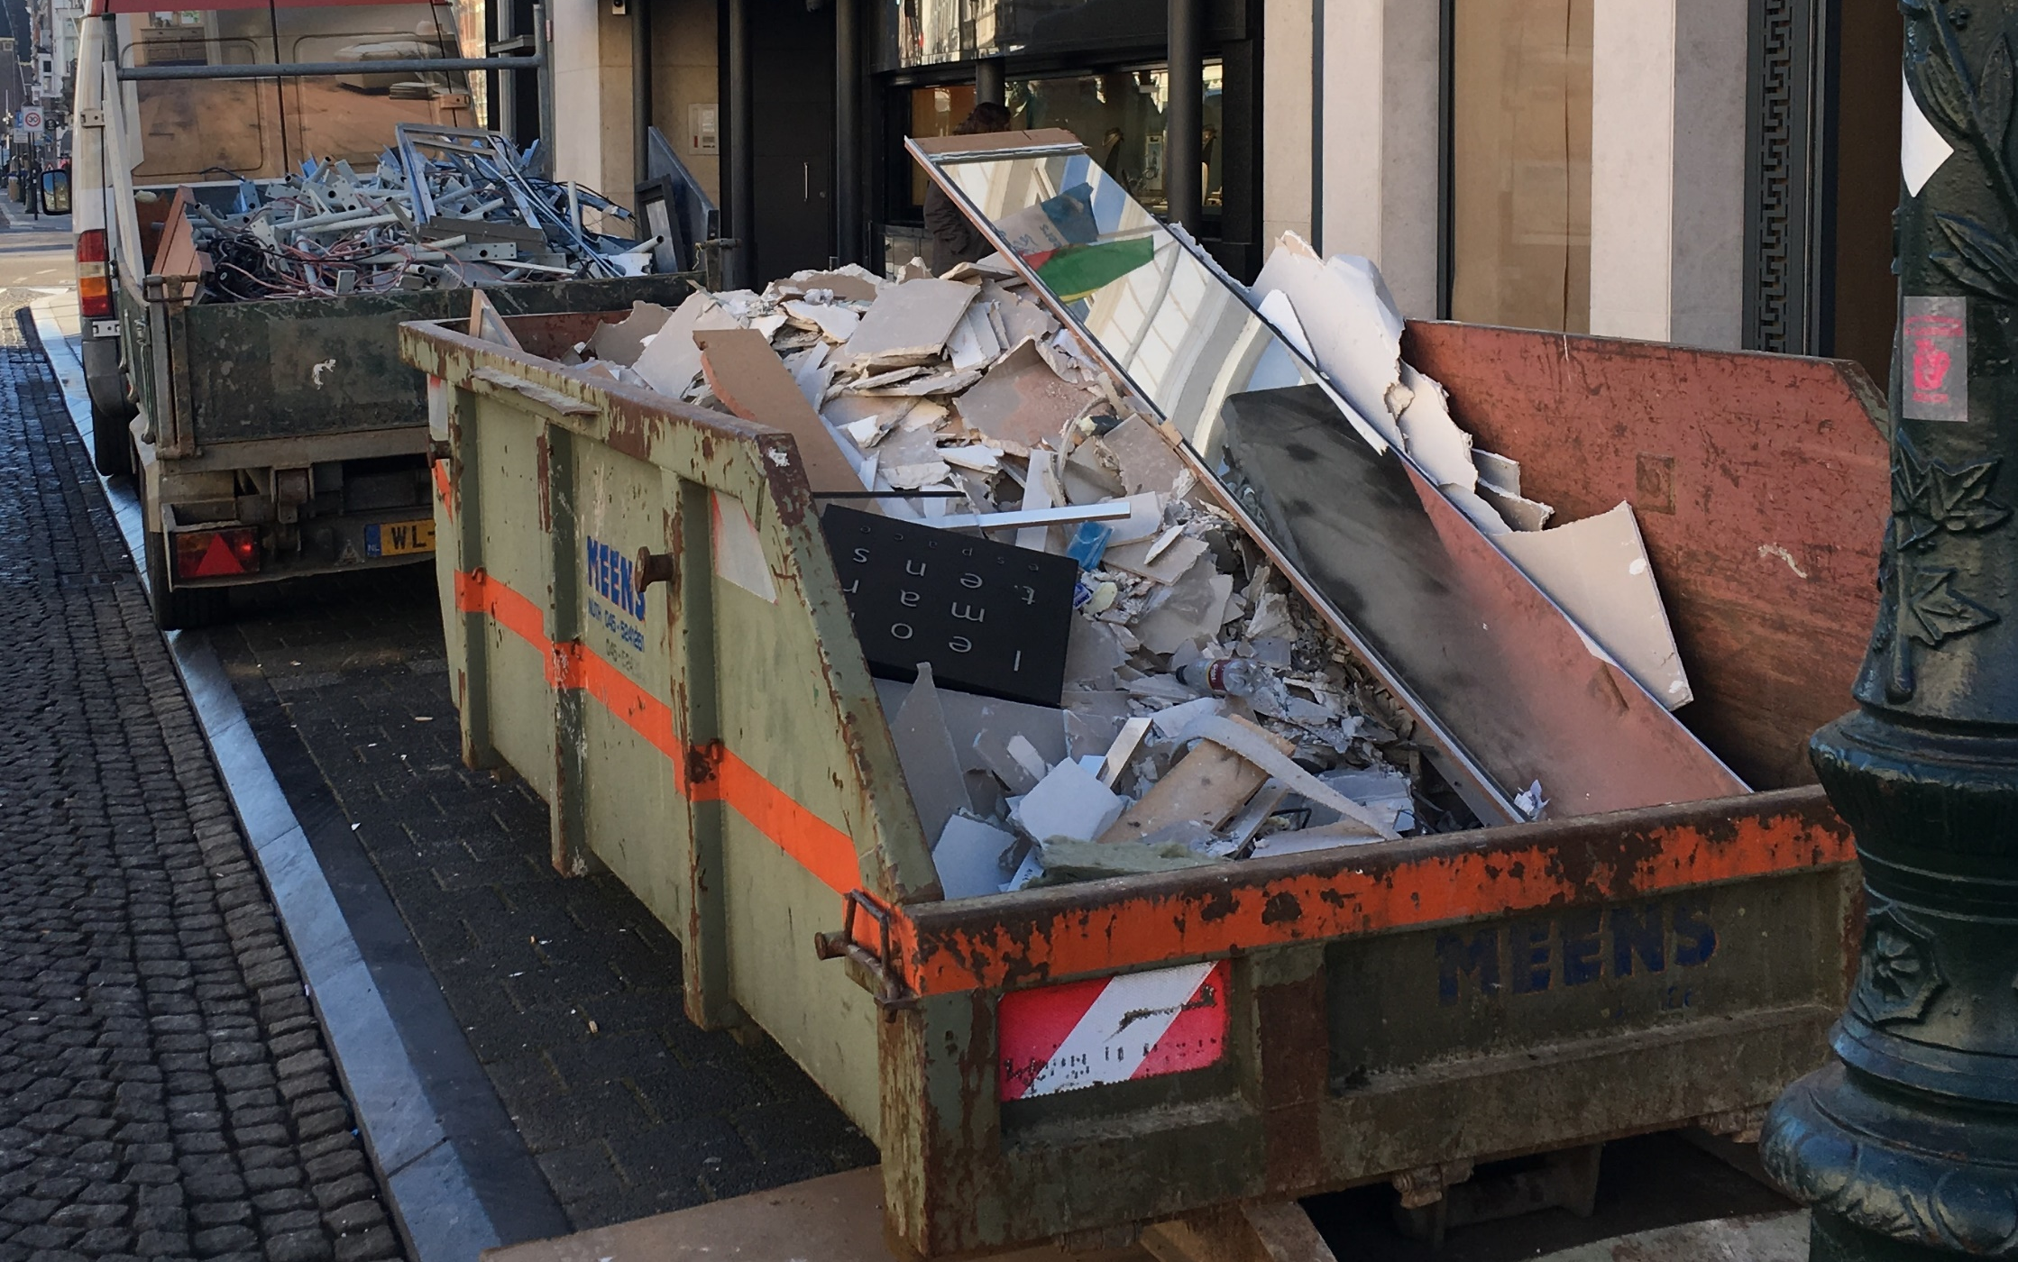
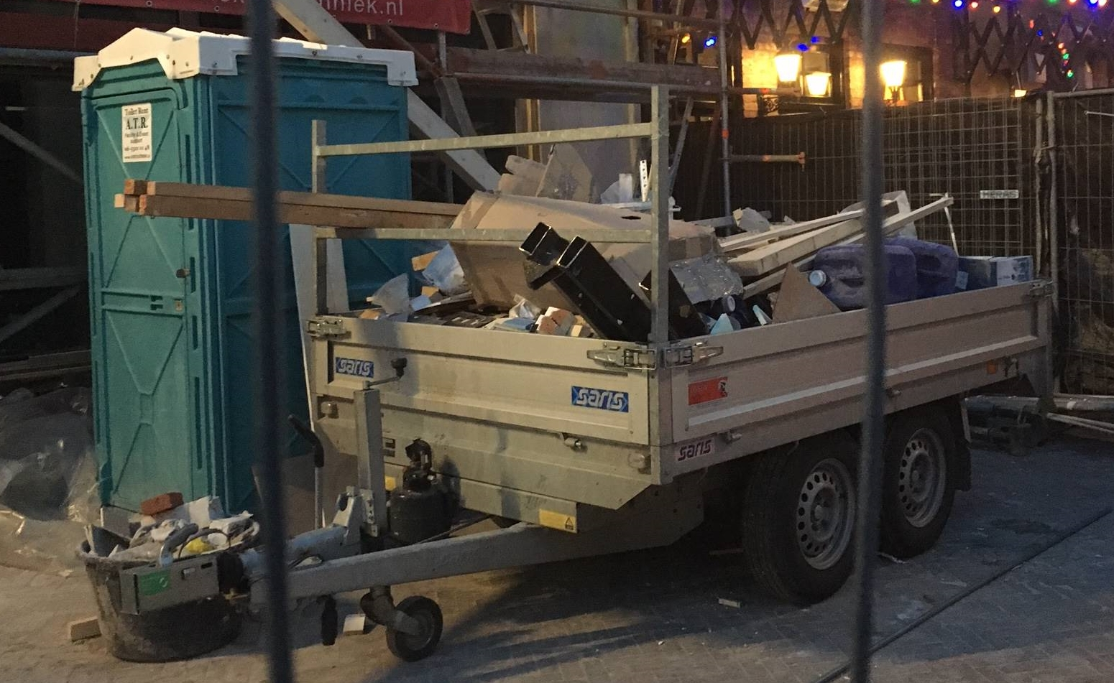
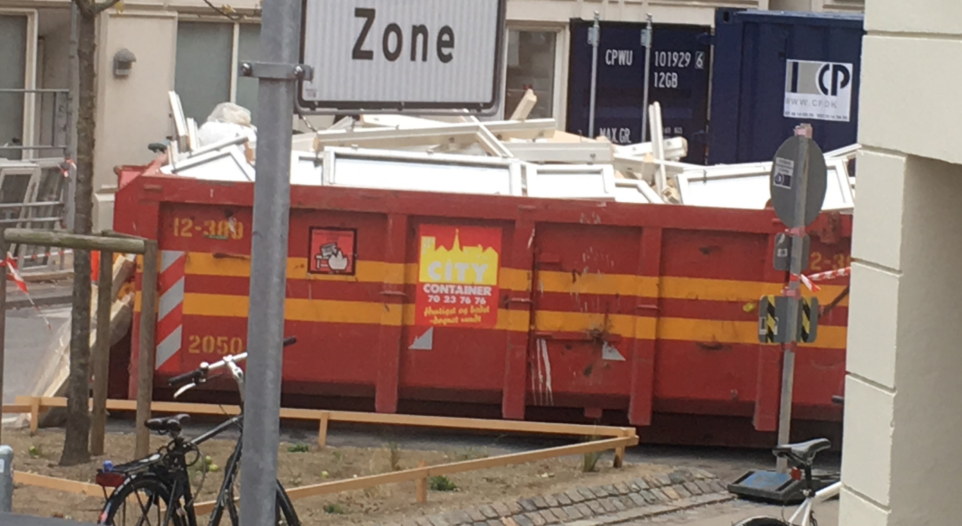
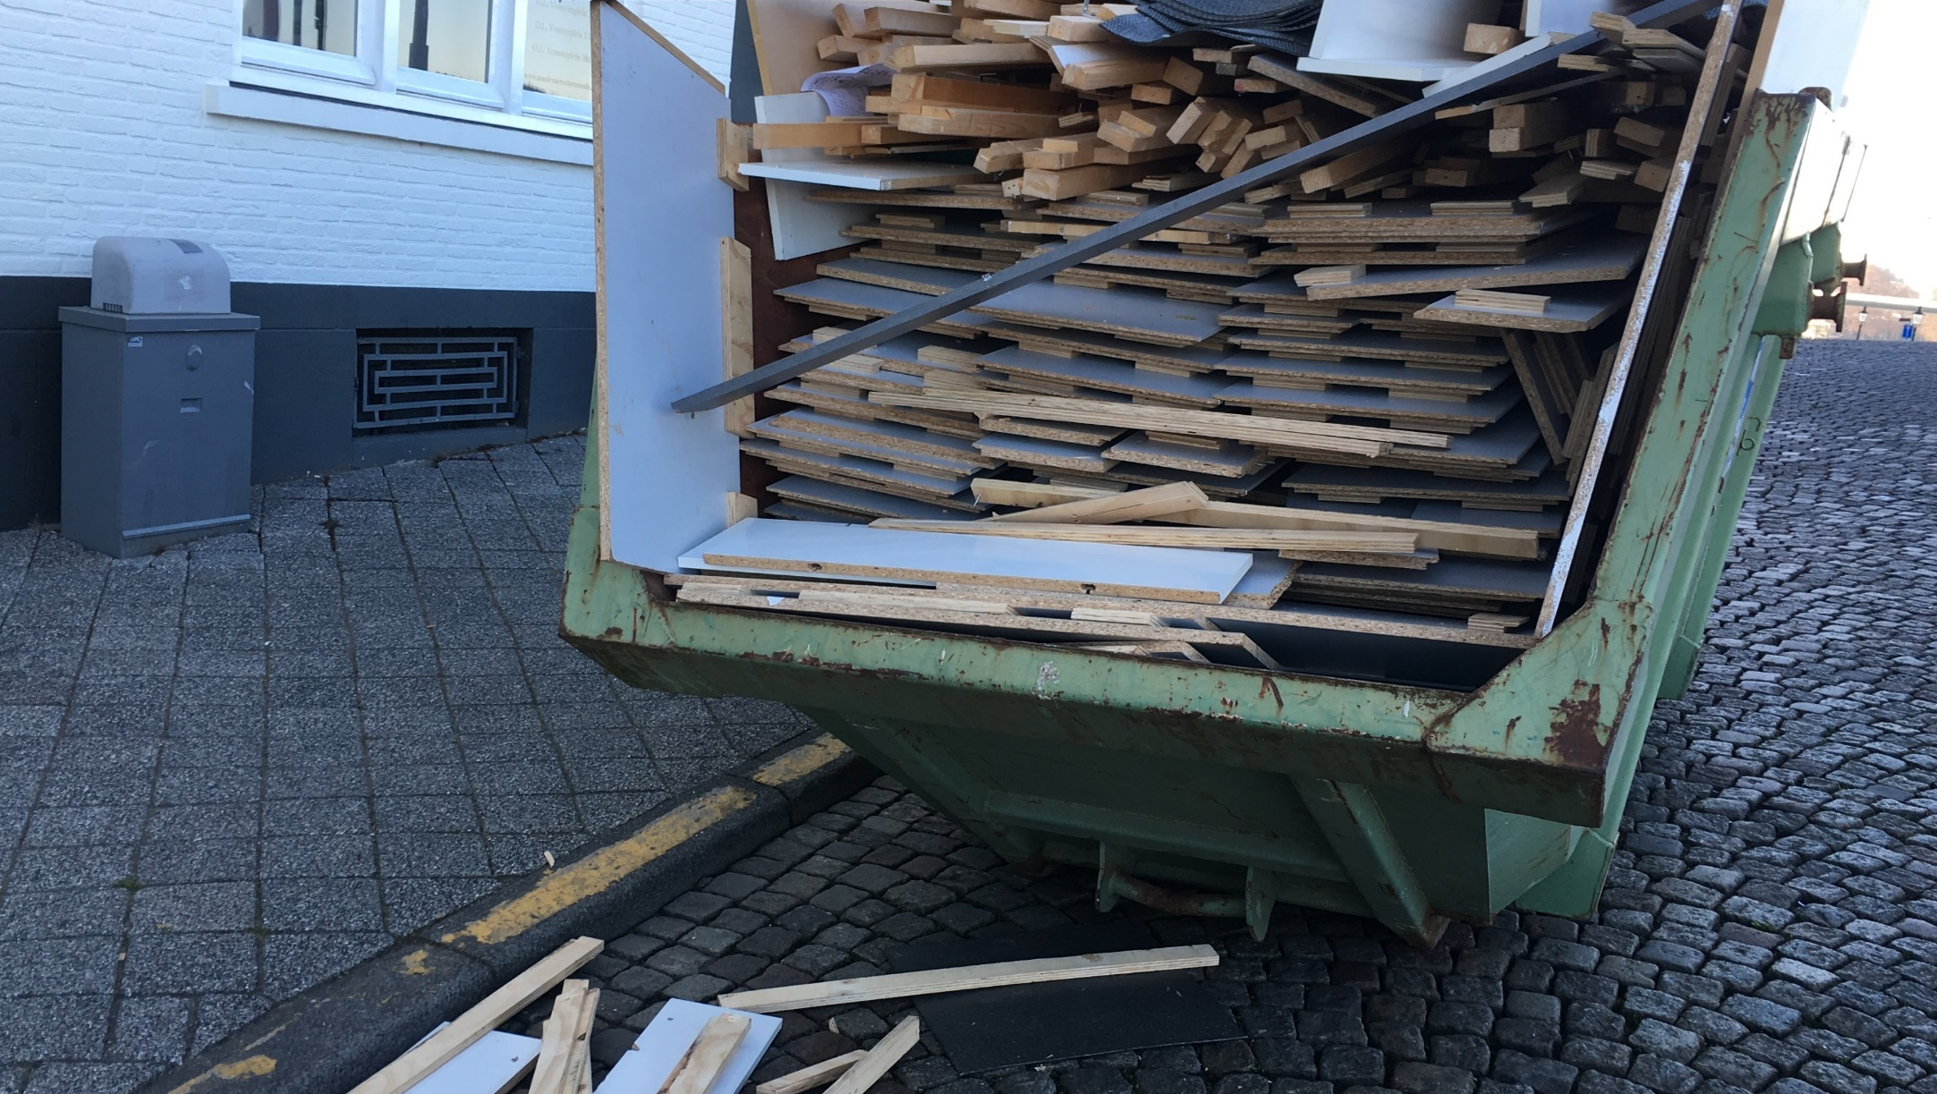



Slide 5
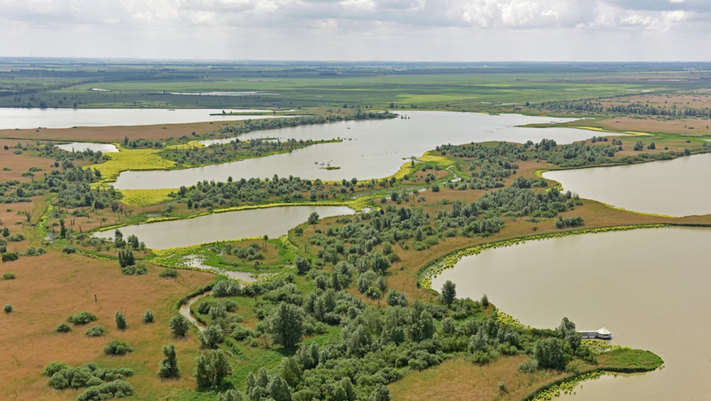

Slide 6
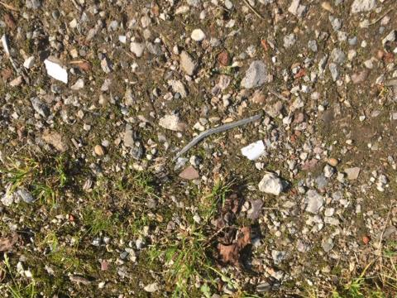
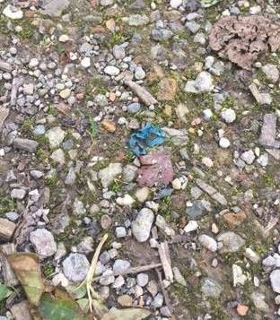
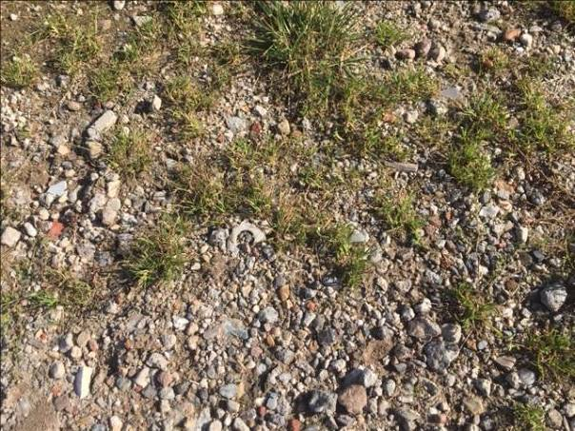
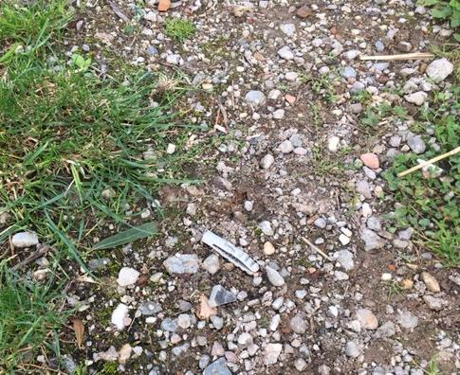
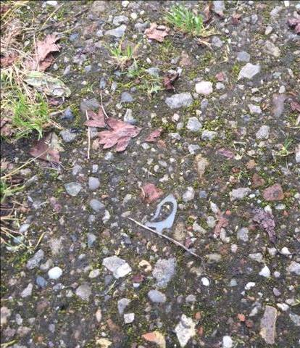
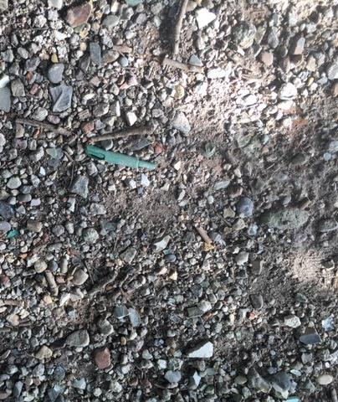
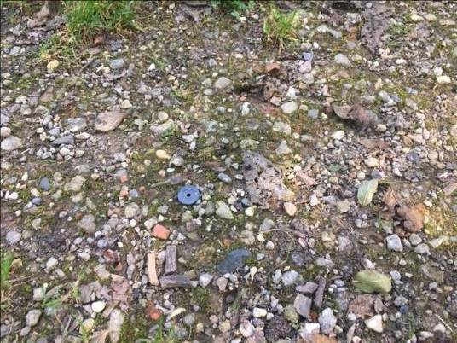

Slide 7
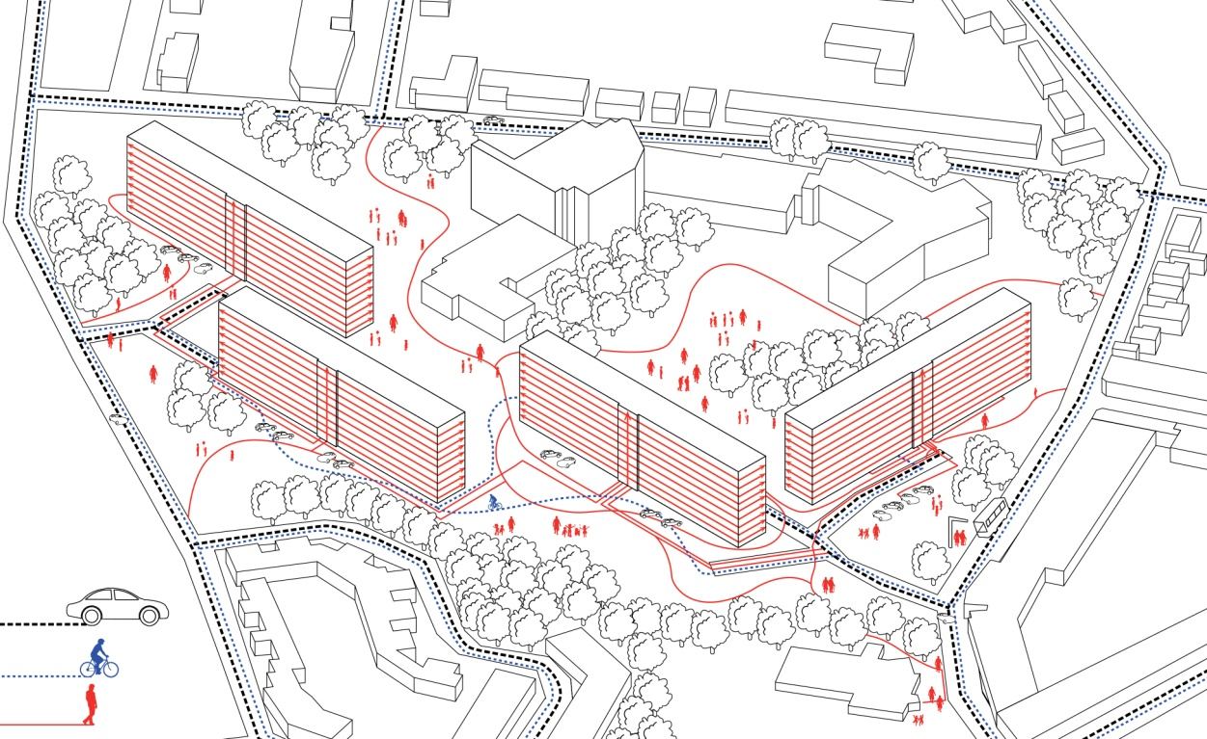
SUPERLOCAL

Slide 8
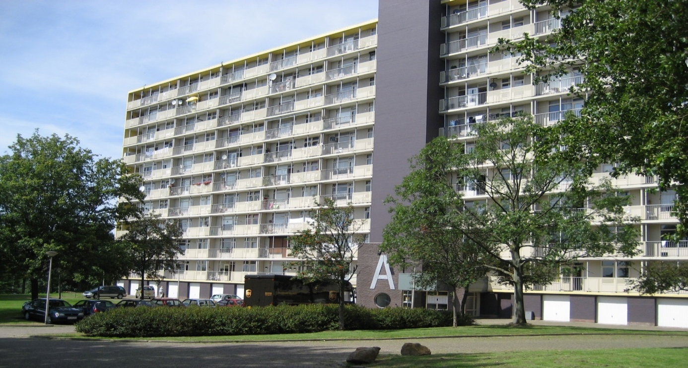

Slide 9
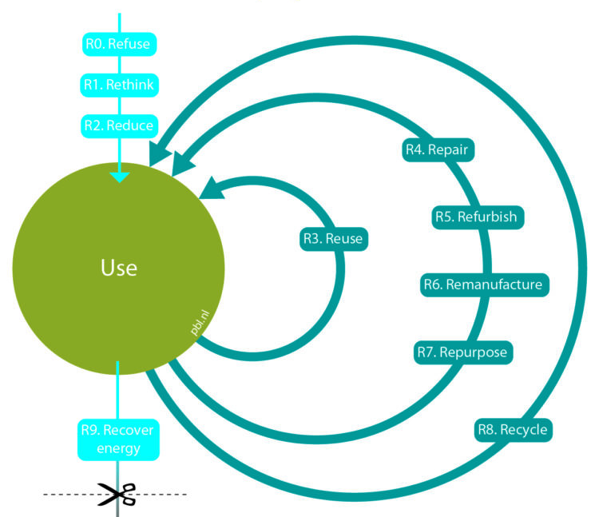
Bron: PBL

Slide 10
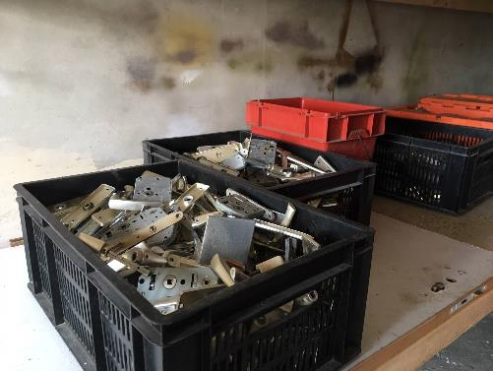
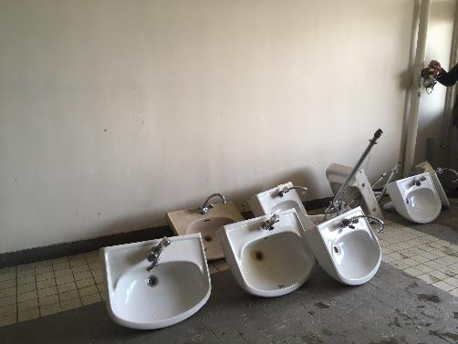
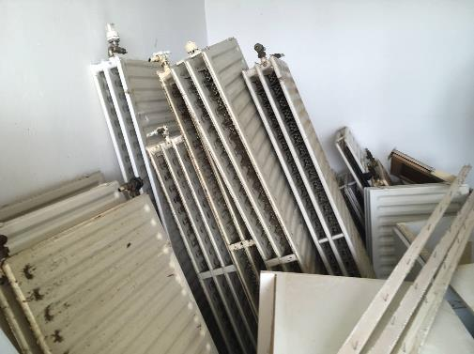
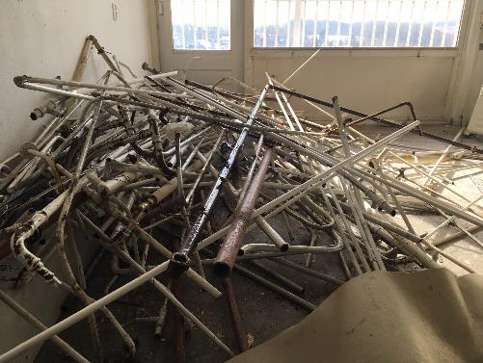
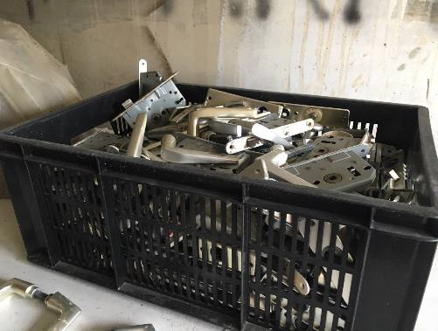
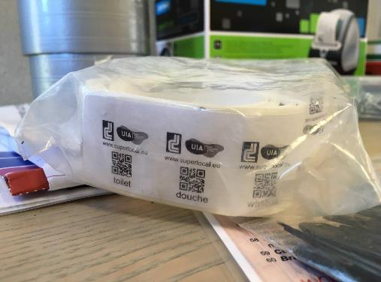
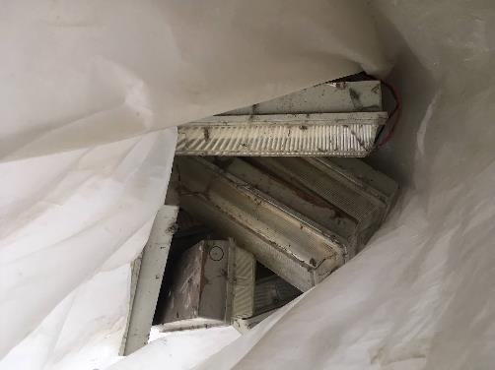
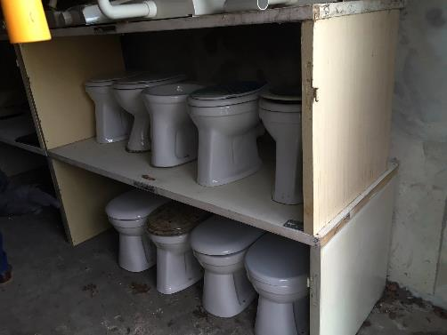
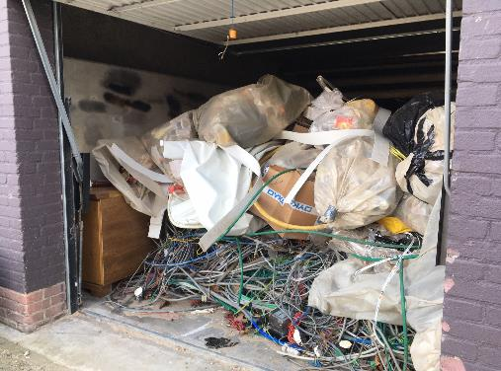

Slide 11
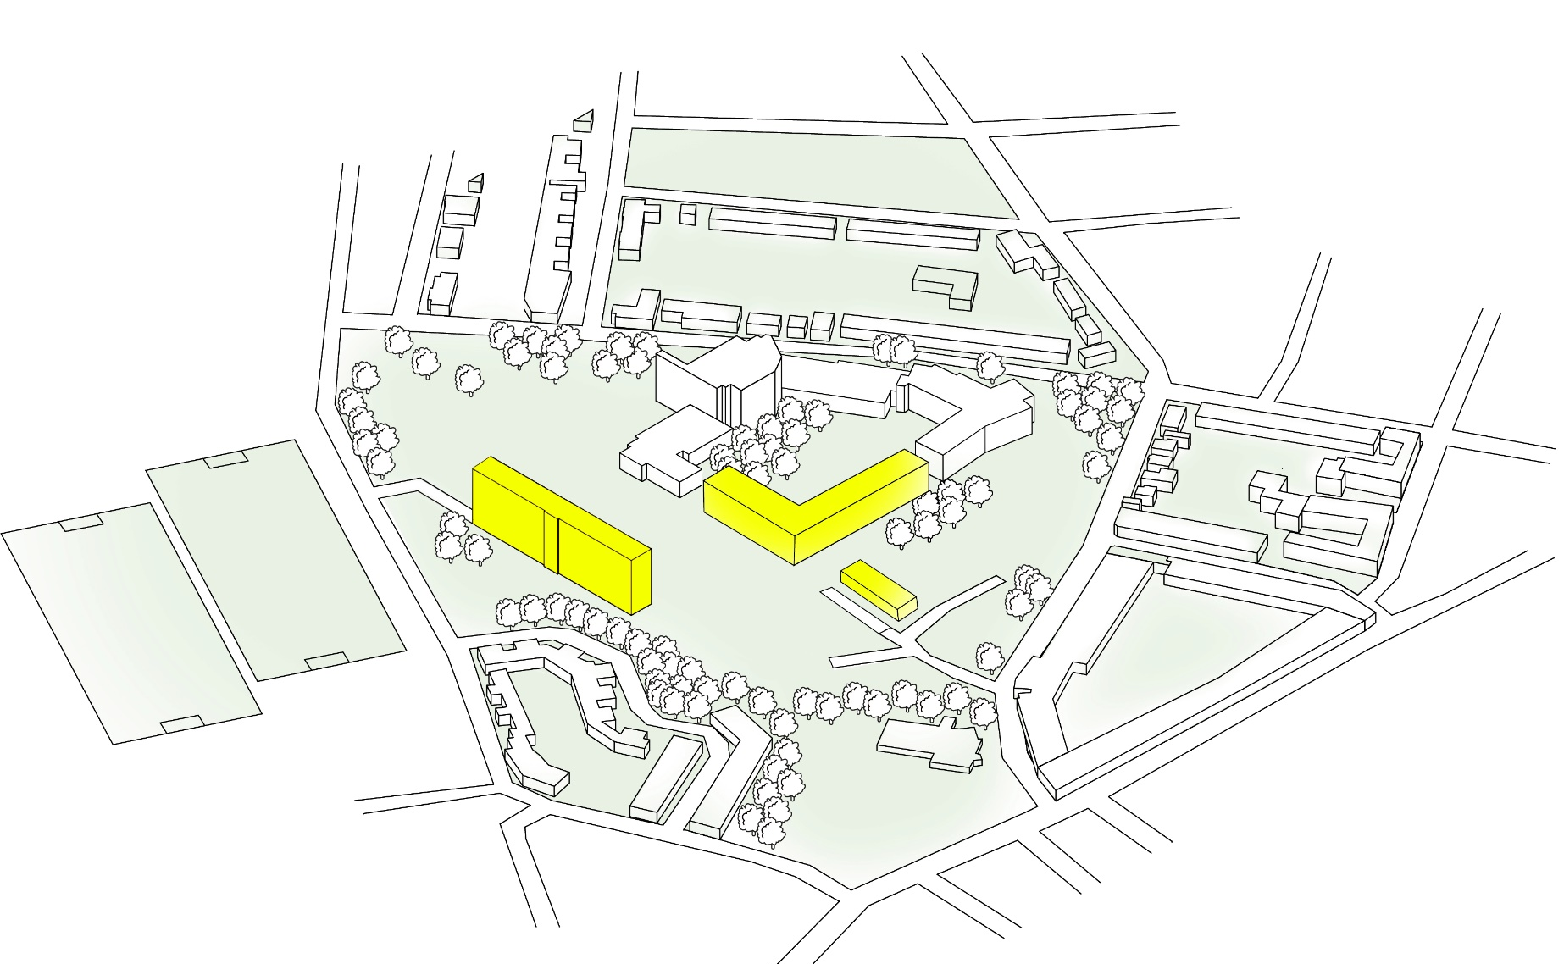
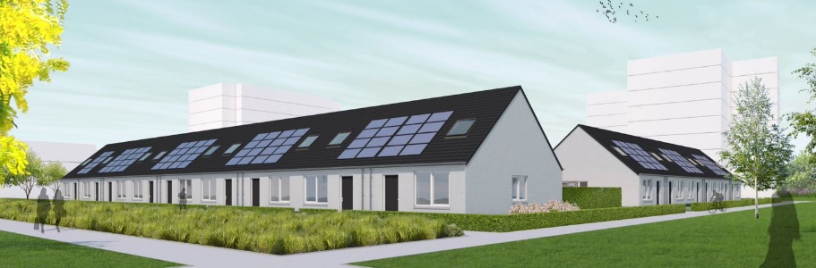
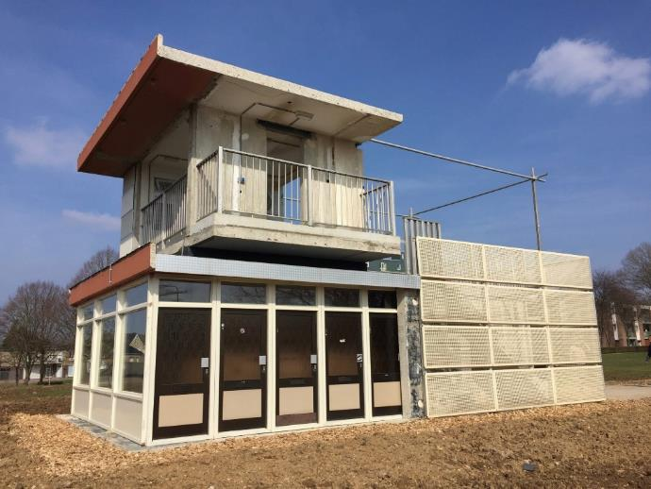
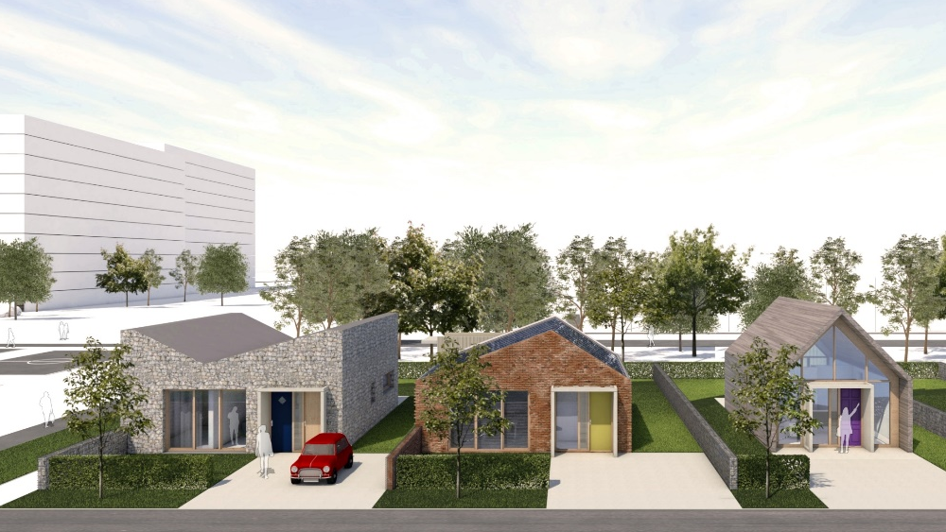
SUPERLOCAL
3. demonstrate – 15 dwellings
1. trial – expo building
2. experiment – 3 dwellings

Slide 12
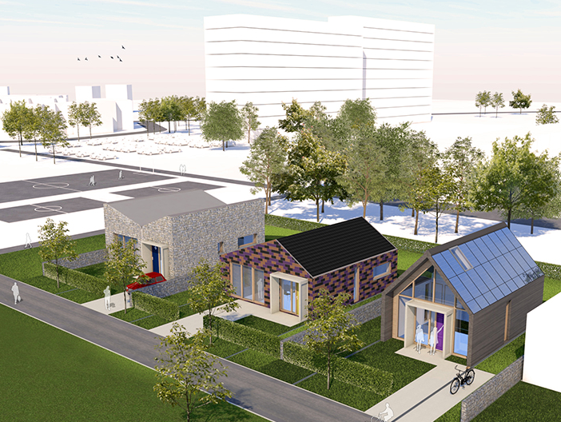
3 dwellings

Slide 13
Environmental impacts
54% savings
Ritzen, 2020

Slide 14
Environmental impacts
Driessen, Ritzen, 2020

Slide 15
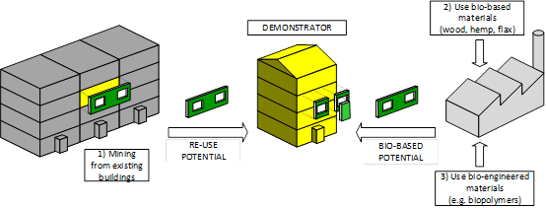
Conceptual model of DRIVE 0 circular deep-renovation solutions
DRIVE 0 focuses on the following three strategies of developing and implementing (scaling up) of circular deep renovation solutions for the existing housing stock:
  re-using and recycling locally available materials by urban mining;
  using renewable environmentally friendly materials;
  using bio-based engineered materials.

Slide 16
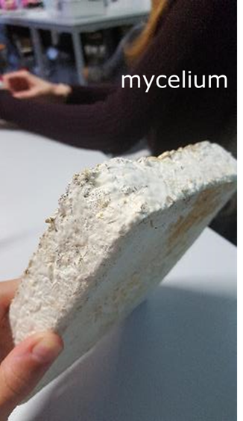
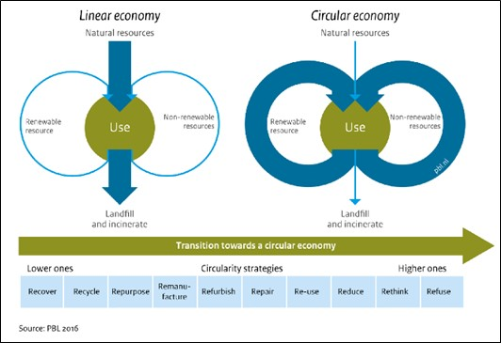
Drive 0 Circular renovation
A circular deep renovation, which contributes to a circular built environment, is based on 100% life cycle renewable energy, and all materials used within the system boundaries are part of infinite technical or biological cycles with lowest quality loss as possible.
The transition from a linear economy to a circular economy based on the 10-R model

Slide 17
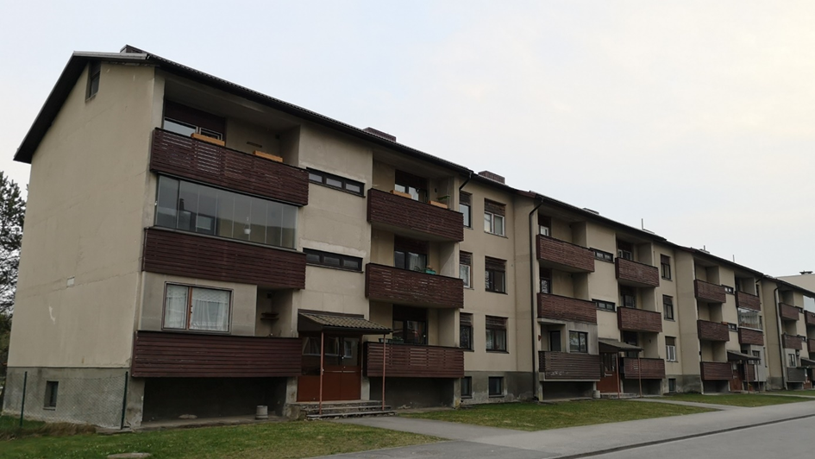
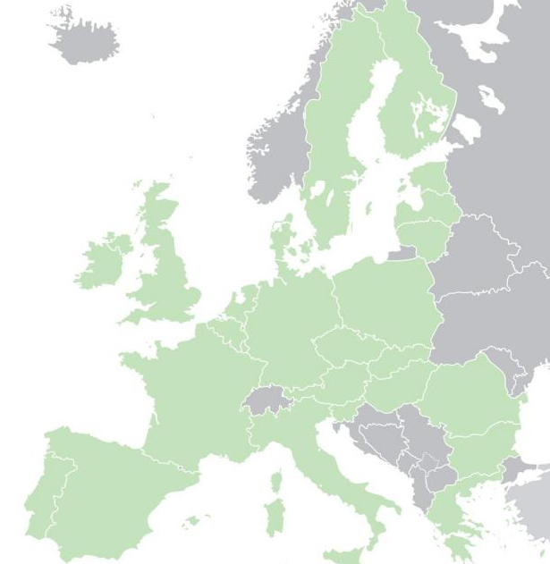
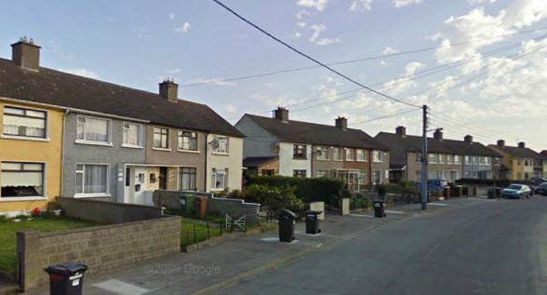
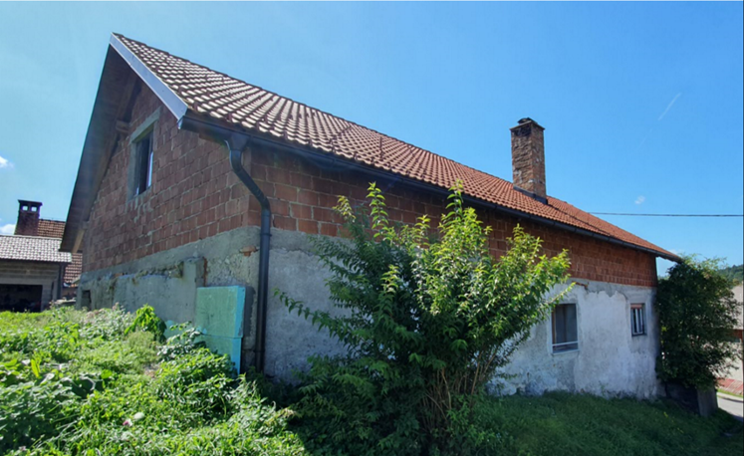
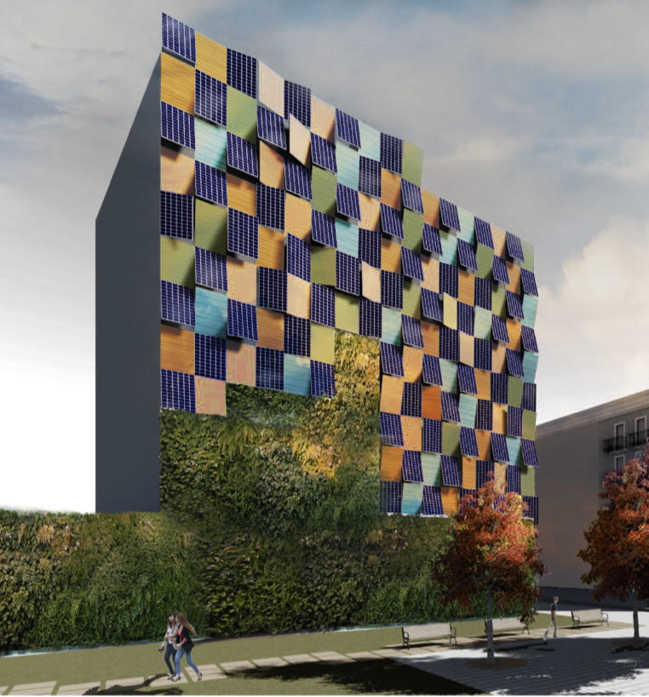
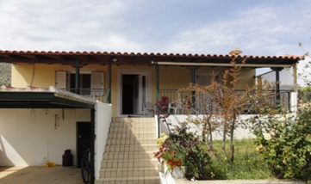
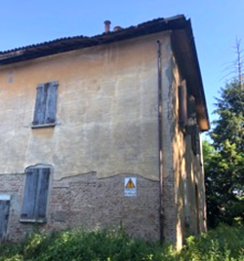
Demonstrators
in Drive 0
The Netherlands
Estonia
Ireland
Slovenia
Spain
Greece
Italy

Slide 18
D6.1 Report on benchmarking on circularity and its potentials on the demo sites
Prepared by:
Zuyd University of Applied Sciences, SURD research team (Dario Cottafava, Michiel Ritzen, John van Oorschot)
Submitted to EASME for a review:
31 Mar 2020
Objectives & Content of D6.1:
The report presents a thorough literature review related to circularity assessment for the built environment by discussing the current state of the art methodologies and approaches.
The report presents a first benchmark assessment of the circularity of the seven demo sites, by linking:
  Building Environmental Assessment (with Embodied Energy and Embodied CO₂ as indicators), with
  Building Circularity Indicators (BCIs), and
  Design for Disassembly (DfD) criteria.
The report indicates mass, Embodied Energy, and Embodied CO₂ of the seven demonstrators, recoverable percentage and DfD indications as directions for development of the demo sites.

Slide 19
Main outcomes & conclusions of D6.1:
Embodied Energy ranges between 1,49 GJ/m2 and 7,60 GJ/m2, while the Embodied CO2 ranges between 0,15 tCO2/m2 and 0,73 tCO2/m2.
The BCI ranges between 0,28; 0,27; and 0,28 and 0,10; 0,13; and 0,12, with respect to the mass, Embodied Energy and Embodied CO2 respectively.
The percentage of recoverable materials, in terms of Embodied Energy, ranges between 20% and 85%.
More precise methodologies with respect to the self-declaration of practitioners and experts are needed to assess the recovering potential of materials.
The report shows a necessity of criteria to indicate to what extent the DfD indicators relate to a material, a component in and of itself and its relationship to its context
 | Building Circularity Indicator
Demonstrators name | DfD criteria inside MCI
 | Mass | EE | EECO₂
1. Parkstad NL | 0,14 | 0,15 | 0,15
2. Barcelona ES | 0,08 | 0,08 | 0,08
3. Dublin IR | 0,10 | 0,13 | 0,12
4. Argelato, IT | 0,23 | 0,22 | 0,22
5. Tallinn, EE | 0,28 | 0,27 | 0,28
6. KI, SI | 0,13 | 0,13 | 0,12
7.A. Attica, GR | 0,20 | 0,20 | 0,20
7.B. Attica, GR | 0,19 | 0,20 | 0,20

Slide 20
Drive 0 Circular renovation
A circular deep renovation, which contributes to a circular built environment, is based on 100% life cycle renewable energy, and all materials used within the system boundaries are part of infinite technical or biological cycles with lowest quality loss as possible.
The transition from a linear economy to a circular economy based on the 10-R model

Slide 21




              www.drive0.eu
Any questions?
Feel free to contact us later.
Michiel Ritzen, michiel.ritzen@zuyd.nl
Ana Tisov, a.tisov@huygen.net (project coordinator)
H2020 Drive 0
@Drive0_H2020
Drive 0 EU H2020

